Slide 1
Able to Build a web application on modern cloud-based architectures and services
(75 hours)
Notes:
Title - The learning outcome
Subtitle - Duration

Slide 2
In this section, we will discuss:
Understanding DevOps, tools, DevOps services in Cloud
AWS Code Commit, Deploy and Pipeline
Notes:
Mention the parent topics one by one. This particular learning outcome has 2 parent topics.

Slide 3
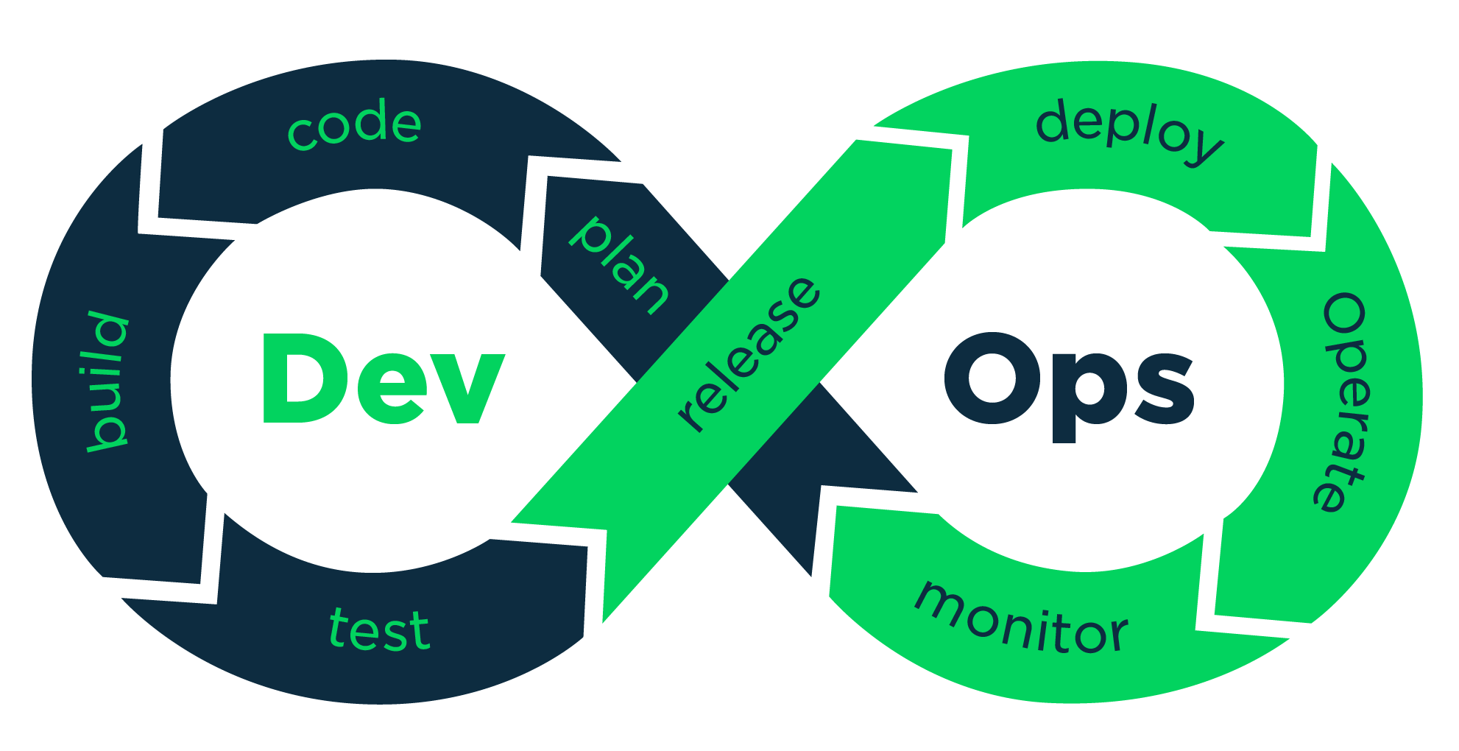
Understanding DevOps, tools, DevOps services in Cloud
DevOps
DevOps lifecycle is defined as a combination of different phases of continuous software development, integration, testing, deployment, and monitoring.
Image Source: https://aws.amazon.com/devops/what-is-devops/
Notes:
Left (White Color space):
Title - Parent Topic
Subtitle - Subtopic 1
Body Text - Description in bullets
Right (Grey Color Space):
Body Text - Relevant image (with source)/code snippet
Reference:
https://www.tutorialspoint.com/internet_technologies/internet_overview.htm/

Slide 4
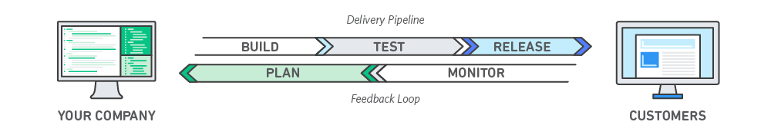
DevOps
What is Dev Ops?
DevOps (a portmanteau of “development” and “operations”) is the combination of practices and tools designed to increase an organization's ability to deliver applications and services faster than traditional software development processes.
Image Source: https://devopedia.org/images/article/54/7602.1513404277.png
Notes:
This slide talks about the case if we have to divide a subtopic further.
Left (White Color space):
Title - Parent Topic
Subtitle - Subtopic of Subtopic
Body Text - Description in bullets
Right (Grey Color Space):
Body Text - Relevant image (with source)/code snippet
DevOps is about removing the barriers between traditionally siloed teams, development and operations. Under a DevOps model, development and operations teams work together across the entire software application life cycle, from development and test through deployment to operations.
Reference:
https://www.tutorialspoint.com/internet_technologies/internet_overview.htm/

Slide 5
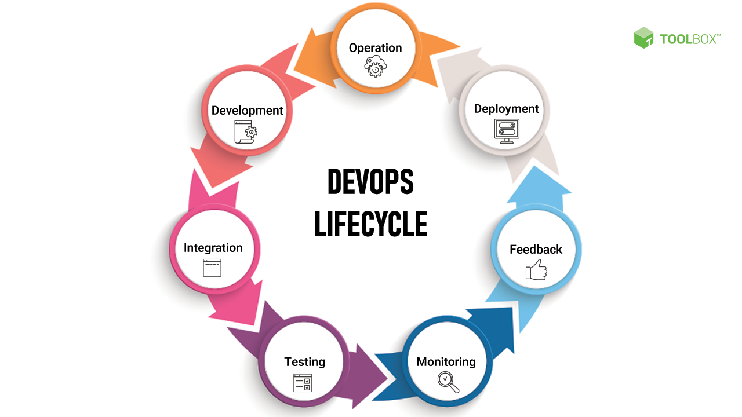
DevOps
DevOps Lifecycle
Code
Build
Test
Release
Deploy
Operate
Monitor
Plan
Image Source: https://pimages.toolbox.com/wp-content/uploads/2021/08/26123909/DevOps-Lifecycle.png
Notes:
Left (White Color space):
Title - Parent Topic
Subtitle - Subtopic of Subtopic
Body Text - Description in bullets
Right (Grey Color Space):
Body Text - Relevant image (with source)/code snippet
Code:
The first step in the DevOps life cycle is coding, where developers build the code on any platform
Build:
Developers build the version of their program in any extension depending upon the language they are using
Test:
For DevOps to be successful, the testing process must be automated using any automation tool like Selenium
Release:
A process for managing, planning, scheduling, and controlling the build in different environments after testing and before deployment
Deploy:
This phase gets all artifacts/code files of the application ready and deploys/executes them on the server
Operate:
The application is run after its deployment, where clients use it in real-world scenarios.
Monitor:
This phase helps in providing crucial information that basically helps ensure service uptime and optimal performance
Plan:
The planning stage gathers information from the monitoring stage and, as per feedback, implements the changes for better performance
Reference:
https://pimages.toolbox.com/wp-content/uploads/2021/08/26123909/DevOps-Lifecycle.png

Slide 6
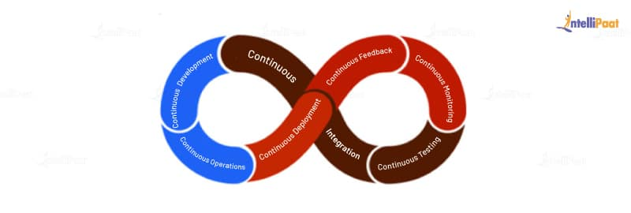
DevOps
Different Lifecycle Stages
Continuous Development
Continuous Integration
Continuous Testing
Continuous Monitoring
Continuous Feedback
Continuous Deployment
Continuous Operations
Image Source: https://intellipaat.com/blog/what-is-devops-lifecycle-and-process/
Notes:
Left (White Color space):
Title - Parent Topic
Subtitle - Subtopic of Subtopic
Body Text - Description in bullets
Right (Grey Color Space):
Body Text - Relevant image (with source)/code snippet
Different Lifecycle Srages
Continuous Development
The continuous development phase involves planning and coding the product the team is developing. In this phase of the DevOps lifecycle, the vision and goal of the project are set, and developers start to code. The integration of development and operations teams helps in planning the work accordingly, increasing the productivity of the team. In this phase, they use tools, such as Git, CVS, Slack, etc.
Continuous Integration
In the continuous integration phase, the source code in the central repository is regularly updated by developers. This phase not only involves compilation but also unit testing, integration testing, code review, and the packaging of the code written by the developers. The tools used in this DevOps process are Jenkins, GitLab, etc.
Continuous Testing
In the continuous testing phase, the code written by developers is sent to testers where they use automated tools to test it for bugs. The beauty of this phase is that they can schedule to run the tests automatically at a predefined time. The report generated in this phase is sent back to the developers where they make necessary updates to the code to remove the bugs.
The tools used in this DevOps process are JUnit (to test the Java code), Selenium, and Docker to simulate a test environment in a container so that the rest of the code is not disturbed.
Continuous Monitoring
The continuous monitoring phase involves monitoring the health, performance, and reliability of the application or code, as well as the infrastructure, as the phases move from development to deployment. The tools used in this phase are Nagios, Sensu, etc.
Continuous Feedback
In the continuous feedback phase of the DevOps lifecycle, the evaluation of the effect of each release on the user experience takes place, and this evaluation is reported back to the team to improve the future releases
Continuous Deployment
In the continuous deployment phase of the DevOps lifecycle, the application is deployed on the production server to make it available for the intended users. The tools used in this phase are AWS CodeDeploy, Octopus Deploy, Jenkins, etc.
Continuous Operations
The continuous operations phase involves the reduction or elimination of planned downtime like scheduled maintenance. The goal of this phase is to increase the uptime or the time the users can use the application. Companies use container management systems like Kubernetes or Swarm in this phase.
Reference:
https://intellipaat.com/blog/what-is-devops-lifecycle-and-process/

Slide 7
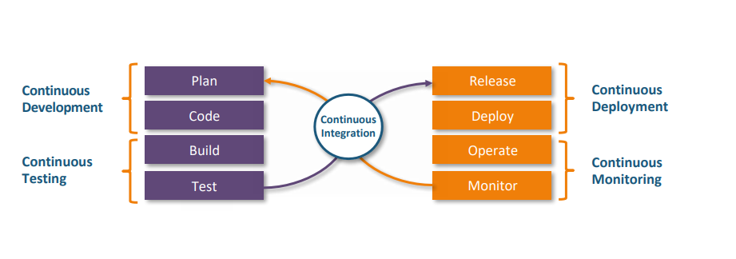
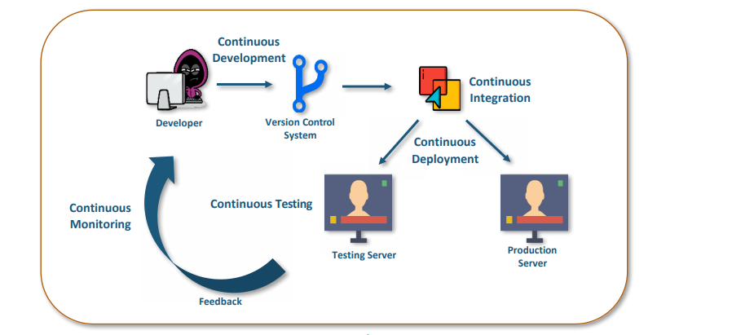
DevOps
How DevOps works?
DevOps is a software development methodology that improves the collaboration between developers and operations teams using various automation tools.
Image Source: https://www.geeksforgeeks.org/how-devops-works/
Notes:
Left (White Color space):
Title - Parent Topic
Subtitle - Subtopic of Subtopic
Body Text - Description in bullets
Right (Grey Color Space):
Body Text - Relevant image (with source)/code snippet
1. Continuous Development:
This stage involves committing code to version control tools such as Git or SVN for maintaining the different versions of the code, and tools like Ant, Maven, Gradle for building/packaging the code into an executable file that can be forwarded to the QAs for testing.
2. Continuous Integration:
The stage is a critical point in the whole DevOps Lifecycle. It deals with integrating the different stages of the DevOps lifecycle and is, therefore, the key in automating the whole DevOps Process.
3. Continuous Deployment:
In this stage the code is built, the environment or the application is containerized and is pushed onto the desired server. The key processes in this stage are Configuration Management, Virtualization, and Containerization.
4. Continuous Testing:
The stage deals with automated testing of the application pushed by the developer. If there is an error, the message is sent back to the integration tool, this tool, in turn, notifies the developer of the error, If the test was a success, the message is sent to Integration-tool which pushes the build on the production server.
5. Continuous Monitoring:
The stage continuously monitors the deployed application for bugs or crashes. It can also be set up to collect user feedback. The collected data is then sent to the developers to improve the application.
Reference:
https://www.geeksforgeeks.org/how-devops-works/

Slide 8
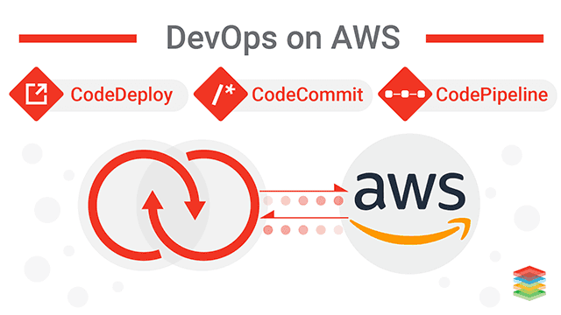
DevOps
Why AWS for DevOps?
Get Started Fast
Fully Managed Services
Built for Scale
Programmable
Automation
Secure
Large Partner Ecosystem
Pay-As-You-Go
Image Source: https://www.scikey.ai/read-blog/540_devops-for-aws-cloud-management.html
Notes:
Left (White Color space):
Title - Parent Topic
Subtitle - Subtopic of Subtopic
Body Text - Description in bullets
Right (Grey Color Space):
Body Text - Relevant image (with source)/code snippet
Get Started Fast
Each AWS service is ready to use if you have an AWS account. There is no setup required or software to install.
Fully Managed Services
These services can help you take advantage of AWS resources quicker. You can worry less about setting up, installing, and operating infrastructure on your own. This lets you focus on your core product.
Built for Scale
You can manage a single instance or scale to thousands using AWS services. These services help you make the most of flexible compute resources by simplifying provisioning, configuration, and scaling.
Programmable
You have the option to use each service via the AWS Command Line Interface or through APIs and SDKs. You can also model and provision AWS resources and your entire AWS infrastructure using declarative AWS CloudFormation templates.
Automation
AWS helps you use automation so you can build faster and more efficiently. Using AWS services, you can automate manual tasks or processes such as deployments, development & test workflows, container management, and configuration management.
Secure
Use AWS Identity and Access Management (IAM) to set user permissions and policies. This gives you granular control over who can access your resources and how they access those resources.
Large Partner Ecosystem
AWS supports a large ecosystem of partners which integrate with and extend AWS services. Use your preferred third-party and open source tools with AWS to build an end-to-end solution. Visit here to learn more about our DevOps Partner Solutions.
Pay-As-You-Go
With AWS purchase services as you need them and only for the period when you plan to use them. AWS pricing has no upfront fees, termination penalties, or long term contracts. The AWS Free Tier helps you get started with AWS.
Reference:
https://www.scikey.ai/read-blog/540_devops-for-aws-cloud-management.html

Slide 9
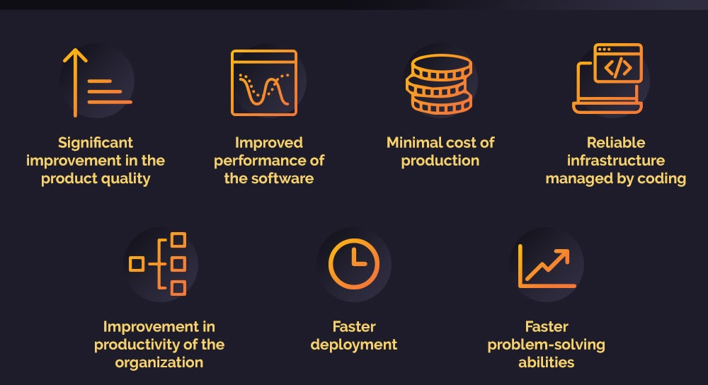
DevOps
Benefits of DevOps
Speed
Rapid Delivery
Reliability
Scale
Improved Collaboration
Security
Image Source: https://www.business2community.com/business-intelligence/9-key-benefits-of-devops-02391855 /
Notes:
Left (White Color space):
Title - Parent Topic
Subtitle - Subtopic of Subtopic
Body Text - Description in bullets
Right (Grey Color Space):
Body Text - Relevant image (with source)/code snippet
Speed:
Move at high velocity so you can innovate for customers faster, adapt to changing markets better, and grow more efficient at driving business results. The DevOps model enables your developers and operations teams to achieve these results. For example, microservices and continuous delivery let teams take ownership of services and then release updates to them quicker.
Rapid Delivery:
Increase the frequency and pace of releases so you can innovate and improve your product faster. The quicker you can release new features and fix bugs, the faster you can respond to your customers’ needs and build competitive advantage. Continuous integration and continuous delivery are practices that automate the software release process, from build to deploy.
Reliability:
Ensure the quality of application updates and infrastructure changes so you can reliably deliver at a more rapid pace while maintaining a positive experience for end users. Use practices like continuous integration and continuous delivery to test that each change is functional and safe. Monitoring and logging practices help you stay informed of performance in real-time.
Scale:
Operate and manage your infrastructure and development processes at scale. Automation and consistency help you manage complex or changing systems efficiently and with reduced risk. For example, infrastructure as code helps you manage your development, testing, and production environments in a repeatable and more efficient manner.
Improved Collaboration:
Build more effective teams under a DevOps cultural model, which emphasizes values such as ownership and accountability. Developers and operations teams collaborate closely, share many responsibilities, and combine their workflows. This reduces inefficiencies and saves time (e.g. reduced handover periods between developers and operations, writing code that takes into account the environment in which it is run).
Security:
Move quickly while retaining control and preserving compliance. You can adopt a DevOps model without sacrificing security by using automated compliance policies, fine-grained controls, and configuration management techniques. For example, using infrastructure as code and policy as code, you can define and then track compliance at scale.
Reference:
https://www.business2community.com/business-intelligence/9-key-benefits-of-devops-02391855

Slide 10
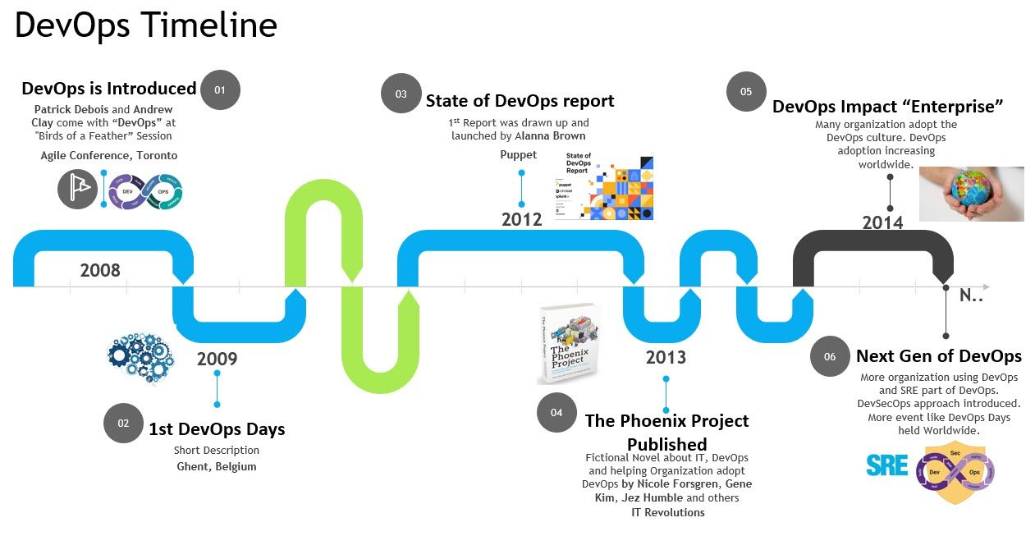
DevOps
History of DevOps
Before DevOps, we had two approaches for software development namely the Waterfall and the Agile.
Image Source: https://blog.devops4me.com/content/images/2020/08/DevOps-timeline-1.jpg
Notes:
Left (White Color space):
Title - Parent Topic
Subtitle - Subtopic of Subtopic
Body Text - Description in bullets
Right (Grey Color Space):
Body Text - Relevant image (with source)/code snippet
The waterfall approach means you're basically stuck until the following release cycle. Similarly, for the “ops” in DevOps, it doesn't matter if you manage to automate deployment and speed up delivery. Waterfall requires a much longer testing time, which could take weeks or even months.
Agile-DevOps is a practice of bringing development and operation teams together. Agile refers to the continuous iterative approach, which focuses on collaboration, customer feedback, small, and rapid releases.
In 2009, the first conference named DevOpsdays was held in Ghent Belgium. Belgian consultant and Patrick Debois founded the conference.
In 2012, the state of DevOps report was launched and conceived by Alanna Brown at Puppet.
In 2014, the annual State of DevOps report was published by Nicole Forsgren, Jez Humble, Gene Kim, and others. They found DevOps adoption was accelerating in 2014 also.
In 2015, Nicole Forsgren, Gene Kim, and Jez Humble founded DORA (DevOps Research and Assignment).
In 2017, Nicole Forsgren, Gene Kim, and Jez Humble published "Accelerate: Building and Scaling High Performing Technology Organizations".
Reference:
https://blog.devops4me.com/content/images/2020/08/DevOps-timeline-1.jpg

Slide 11
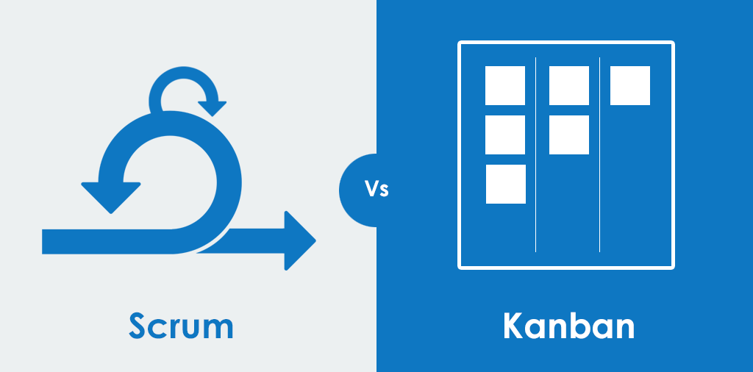
DevOps
DevOps methodologies
Scrum
Kanban
Scaled Agile Framework (SAFe)
Lean development
Extreme programming (XP)
Image Source: https://www.addteq.com/blog/2019/11/kanban-vs-scrum-lets-understand-the-difference/
Notes:
Left (White Color space):
Title - Parent Topic
Subtitle - Subtopic of Subtopic
Body Text - Description in bullets
Right (Grey Color Space):
Body Text - Relevant image (with source)/code snippet
Scrum—a framework in which people can address complex adaptive problems while delivering products of the highest possible value.
Kanban—a method for managing the creation of products with an emphasis on continual delivery while not overburdening the development team. Like Scrum, Kanban is a process designed to help teams work together more effectively.
Scaled Agile Framework (SAFe)—a set of organization and workflow patterns intended to guide enterprises in scaling lean and agile practices. SAFe is one of a growing number of frameworks that seek to address the problems encountered when scaling beyond a single team.
Lean development—a translation of lean manufacturing principles and practices to the software development domain. Lean offers a conceptual framework, values, and principles, as well as best practices derived from experience, that support agile organizations.
Extreme programming (XP)—a software development methodology intended to improve software quality and responsiveness to changing customer requirements. XP advocates frequent releases in short development cycles, intended to improve productivity and introduce checkpoints at which new customer requirements can be adopted. Other elements of extreme programming include programming in pairs or doing extensive code review, unit testing of all code, not programming of features until they are needed, a flat management structure, code simplicity and clarity, expecting changes in the customer’s requirements as time passes and the problem is better understood, and frequent communication with the customer.
Reference:
https://www.addteq.com/blog/2019/11/kanban-vs-scrum-lets-understand-the-difference/

Slide 12
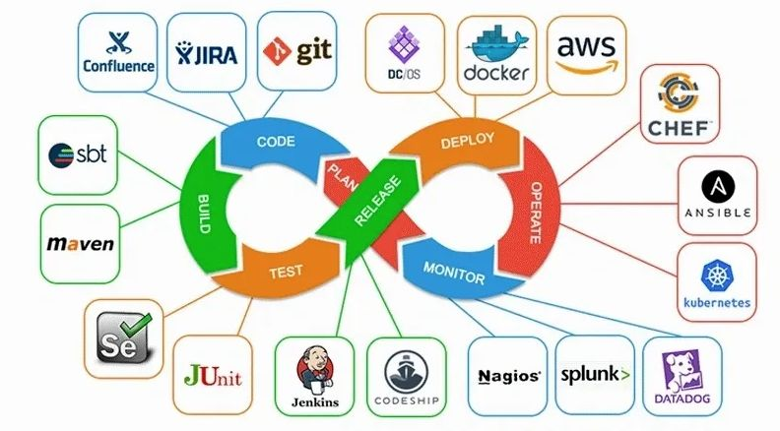
DevOps
DevOps Tools
Git
Docker
Selenium
Jenkins
Ansible
Puppet
Nagios
Chef
Image Source: https://simpat.tech/wp-content/uploads/2021/09/devops-architecture-diagram.jpg
Notes:
Left (White Color space):
Title - Parent Topic
Subtitle - Subtopic of Subtopic
Body Text - Description in bullets
Right (Grey Color Space):
Body Text - Relevant image (with source)/code snippet
Git
Git is an open-source, distributed, and the most popular software versioning system. Git has several sets of commands used to perform various operations. It works on a client-server model, which basically means that there is a central server that holds the main repository of code. Code can be downloaded from the main repository simultaneously by various clients or developers. Git is developed by Linus Torvalds. Git facilitates teams that are located at geographically different places to collaborate on the same project. Popular companies like Google, Facebook, Microsoft, Netflix extensively use Git in their CI/CD pipelines.
Docker
Docker is a containerization technology. Containers consist of all the applications with all of their dependencies. These containers can be deployed on any machine without caring about underlying host details. Containers can be a .net application or a website along with its dependencies like .net or lamp stack in case of a website application. These containers are used to automate the deployment process of applications in production and non-production environment.
Selenium
Selenium is an open-source, automated testing framework. Selenium is used majorly to automate the testing of web applications. We can define test in selenium which we want to test against our application. Selenium can repeatedly apply those tests to our application without manual intervention and generate reports. These reports can be used by testing individuals to see if the application is behaving correctly or not.
Jenkins
Jenkins is an open-source automation server written in java. Jenkins provides automation of the continuous delivery part. Jenkins is used in creating continuous delivery pipelines. To give you an example, here is a scenario wherein a Jenkins server will take our application container from the development environment and make it accessible to the testing environment, QA environment, or any other non-production environment in the beginning. Jenkins server is in the middle of the whole CI/CD pipeline. It automates this whole process which means whenever a developer commits a change in a code that code will automatically be visible to the testing server or QA team. They then can provide instantaneous feedback on these changes. Jenkins is used by Microsoft, Redhat, Rackspace, to name a few.
Ansible
Ansible is an open-source application that is used for automated software provisioning, configuration management, and application deployment. Ansible is the backbone of controlling an automated cluster environment consisting of many machines. Ansible works on the client-server model. The client acts as a master, which is the center point in our cluster and provides centralized control of all client machines (slaves) that are connected to it. We can give any command to any client machine or deploy any application to more than one machine from a single master machine. Ansible only requires SSH for communication so it does not need any software dependency to run. Ansible works on Unix.
Puppet
Puppet is an open-source software configuration management, automated provisioning tool. It is an alternative to Ansible and provides better control over client machines. Puppet comes up with GUI which makes it easier to use than Ansible. Puppet is cross-platform, it runs on both Unix and Microsoft Windows. Puppet uses a manifest file and applies those specifications across all machines. Unlike Ansible, Puppet is an agent-based tool. The Puppet master runs on a master machine and the Puppet agent runs on all client machines. Puppet is used by Microsoft, Google, Accenture, etc.
Nagios
Nagios is used for continuous monitoring of infrastructure. Nagios provides server monitoring, application monitoring, and network monitoring. With Nagios, we can monitor a whole data center from a single server. We can see whether switches are working correctly, servers are not having too much load, or if any part of the application is down. It provides a nice GUI interface to check various details like how much memory is used, what is the fan speed, routing tables of switches, or the state of the SQL server. Nagios has a modular design. It supports NRPE plugins which can be used to add monitoring parameters on existing Nagios. There are various plugins available on the internet which can be used freely to add features to Nagios. Nagios is the most popular tool in continuous monitoring.
Chef
Chef is a configuration management tool. Chef is used to manage configurations like creating or removing a user, adding an SSH key to a user present on multiple nodes, installing or removing a service, etc. We can manage up to 10,000 nodes by using chef. These changes are pushed by cookbooks or recipes. Chef has three components viz. Chef server, workstation, and nodes. The Chef server is a central point where all details of our Chef infrastructure reside. Chef workstation holds recipes or cookbooks which pushes particular configurations to our chef infrastructure. Nodes are simple machines that are configured using chef. Chef has API support from AWS, Azure, Rackspace, which makes it easy to use with infrastructure-as-code methodology.
Reference:
https://simpat.tech/wp-content/uploads/2021/09/devops-architecture-diagram.jpg

Slide 13
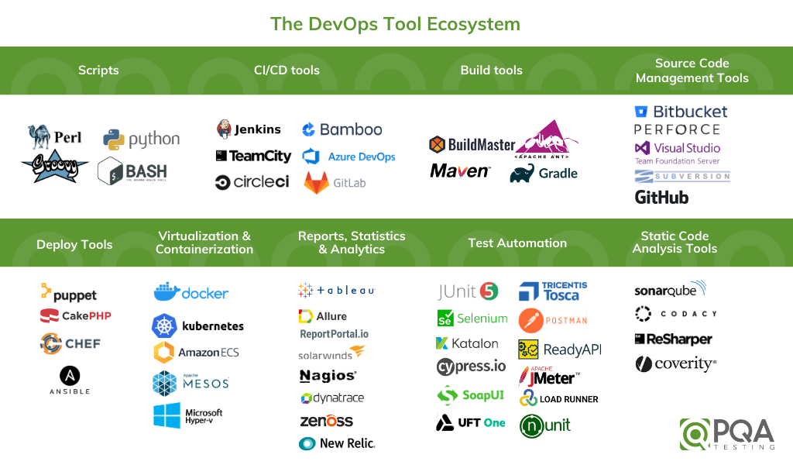
DevOps
DevOps Tools
SVN
Rational Clearcase
Maven
Apache Ant
Kubernetes
SignalFx
Prometheus
Image Source: https://www.pqatesting.com/wp-content/uploads/2020/11/The-DevOps-Tool-Ecosystem.png
Notes:
Continuing from the last slide:
Left (White Color space):
Title - Parent Topic
Subtitle - Subtopic of Subtopic
Body Text - Description in bullets
Right (Grey Color Space):
Body Text - Relevant image (with source)/code snippet
SVN
SVN or Subversion is an open-source, centralized software versioning & revision control system. SVN is an alternative to GIT. SVN is a centralized system which means every time if a team member or client wants to make changes in the code he has to inform the central server or repo about these changes. To use an SVN repo, the client needs to connect to the central server. It can check out the code to download the repo from the server. The client then moves on to make changes in this code and commit this change by informing the central repo. From the central repo, these changes will be visible to other team members or clients.
Rational ClearCase
Rational ClearCase manages changes across the software lifecycle. ClearCase is used in Software configuration management of source code. ClearCase is used in both hardware and software development. The center of ClearCase is a secure data repository. It has data that is shared by all users including accounting data and historical data on development processes themselves. It shows details like which user implemented which version, when, and why. There are 3 products of ClearCase—Rational ClearCase is for medium to large teams, Rational ClearCase LT is useful for small to medium teams, and Rational ClearCase multisite is used by geographically distributed teams.
Maven
Maven is a build automation tool. It automates the software build process & dependencies resolution. A Maven project is configured using a project object model or POM.XML file which describes the build process and the software project, its dependencies on external modules and components, build order, directories. Maven can dynamically download these external modules & Maven plugins during the build process itself. Maven can build and manage projects on Java, C#, Scala, Ruby, and other languages. Maven is majorly used by Apache Foundation to automate the build of some of its large projects like Apache Hadoop.
Apache Ant
Apache Ant is a software tool used for the automation of the software build process. Apache Ant is inspired by Unix make utility. Apache Ant uses an XML file build.xml in place of makefile which is used by make utility for build processes. It automates repetitive tasks in the build process and generates documentation. Ant builds are based on three blocks viz. tasks, targets, and extension points. Ant supports many third-party extensions like Eclipse IDE and NetBeans IDE.
Kubernetes
Kubernetes is an open-source container orchestration tool. It is developed by Google. It is used in continuous deployment and auto-scaling of container clusters. It increases fault tolerance, load balancing in a container cluster. Kubernetes maintains the desired state of a cluster; this desired state is described in the YAML file. YAML file contains the state of pods or slave nodes and replication unit for a cluster. Kubernetes uses this YAML file to maintain the desired state of the cluster. For example, in case, a pod is serving more requests than another pod, then it can automatically distribute the load to other pods. In case one machine fails, then it can configure another pod to replace it thus ensuring fault tolerance, load balancing, and high availability in a cluster. Kubernetes is used in high-performance data centers like that of Google, Facebook, and Amazon Web Services.
SignalFx
SignalFx, which recently got acquired by Splunk, is a complete observability tool. It can collect traces, metrics, and events from applications and infrastructure to help inform users of not only the system’s health but why it is behaving a certain way. This helps teams to fix issues faster as well as connect application and infrastructure monitoring with the requirements of the business. SignalFx is great to use for debugging and post-incident reviews through high cardinality analytics, service mapping, and detailed visualizations and dashboards.
Prometheus
Prometheus is an open-source, time-series database and monitoring tool that is mostly used by DevOps and IT teams. It generates alerts based on time-series data. One can generate precise alerts and visualizations to get business insights and engineering outcomes. Developers and IT practitioners can easily customize the tool for their own use cases. Following are some of its features:
Functional sharding and federation helps with scaling
Easy service instrumentation with numerous client libraries
PromQL enables powerful reporting capabilities
Reference:
https://www.pqatesting.com/wp-content/uploads/2020/11/The-DevOps-Tool-Ecosystem.png

Slide 14
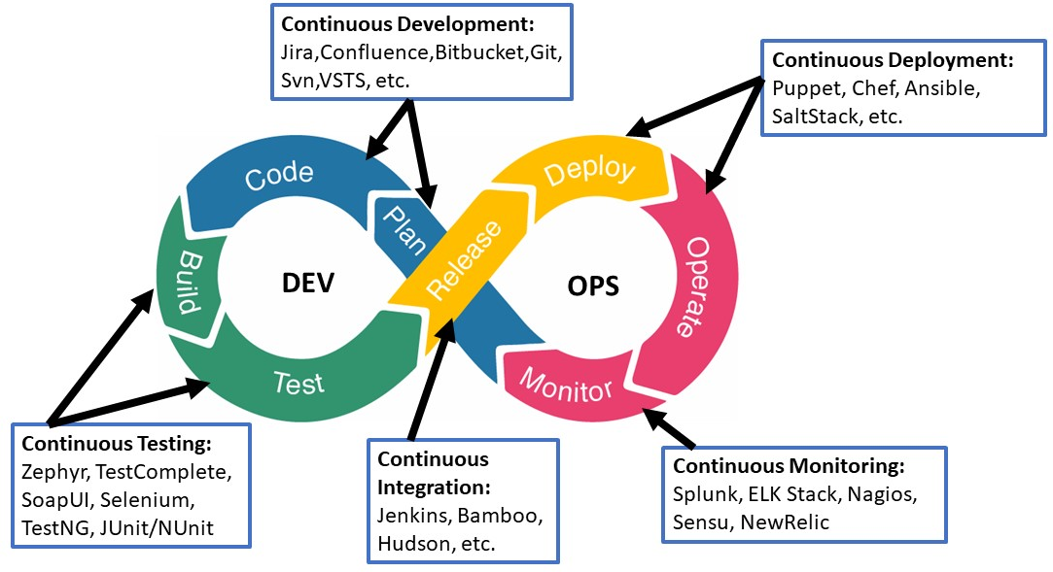
DevOps
DevOps Tools
Splunk Cloud
Raygun
Catchpoint
Splunk On-Call
Gremlin
JUnit
Image Source: https://smartbear.com/blog/devops-testing-strategy-best-practices-tools/
Notes:
Continuing from the last slide:
Left (White Color space):
Title - Parent Topic
Subtitle - Subtopic of Subtopic
Body Text - Description in bullets
Right (Grey Color Space):
Body Text - Relevant image (with source)/code snippet
Splunk Cloud
Splunk Enterprise and Splunk Cloud are log management, infrastructure monitoring, and application monitoring tools. It can collect data from services and devices as well as other monitoring tools such as DevOps monitoring tools. Splunk serves as the single source of truth for the health and performance of a system. Its powerful log search, filtration functionality, and informative visualizations and dashboards lead to quicker incident resolution. Splunk provides observability and provides the tools required to take action whether there is an on-premises architecture or in a cloud environment. Splunk when paired with VictorOps creates complete observability, data-driven incident management, and on-call incident response.
Raygun
Raygun generates real insights into the way users experience a service. It has the ability to provide detailed reports on everything like full-scale app crashes, downtime, performance metrics like load speeds, network latency, etc. Its real-user monitoring can identify and expose both client-side and server-side problems for users as well as help product teams give priority to engineering roadmaps to align with real problems. The APM tool works well with Raygun’s error management workflow. It automatically links errors back to the source code. This brings Development and Operations together through a single source of truth for the entire team—performance problems and the cause of errors.
Catchpoint
The Catchpoint monitoring tool combines synthetic monitoring, real-user monitoring, network monitoring, and endpoint monitoring for the detection of errors and incidents anywhere in an architecture. The ability to run synthetic metrics through the system is a unique advantage as compared to others. For smaller teams who don’t have large amounts of real metrics, it can help you find service reliability or performance problems as you scale before customers notice it. Catchpoint helps identify issues whether it’s caused by a user’s browser or device or an application or infrastructure problem.
Splunk On-Call
With Splunk On-Call, one can alert engineers and on-call responders about problems and incidents in real-time as well as provide contextual alert information and remediation instructions. In one single pane of glass, DevOps and IT practitioners can collaborate to drastically reduce the time taken to acknowledge and resolve incidents. With reports like MTTA/MTTR, Post-Incident Review, Incident Frequency, teams can drive swift problem resolution, manage alert noise, reduce burnout, etc.
Gremlin
Netflix popularized chaos engineering as a means to simulate chaos through systems in order to test the response to stress and unpredictable events. Gremlin lets you design experiments according to your liking to conduct or simply re-enact issues experienced in the past and run them through your applications and services to see how they handle it.
JUnit
JUnit is the de-facto test automation tool for Java. No matter if JUnit is used for writing unit or integration tests or even if another framework is used in conjunction with it - such as Selenium - the output results file can be uploaded to Zephyr Scale for generating reports and leveraging all the other capabilities
Reference:
https://smartbear.com/blog/devops-testing-strategy-best-practices-tools/

Slide 15
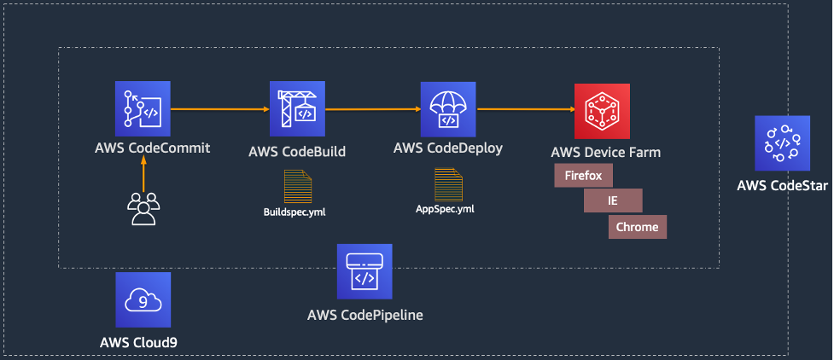
DevOps
DevOps services
AWS CodePipeline
AWS CodeBuild
AWS CodeDeploy
AWS CodeStar
Image Source: https://d2908q01vomqb2.cloudfront.net/7719a1c782a1ba91c031a682a0a2f8658209adbf/2021/02/10/Figure1-3.png
Notes:
Continuing from the last slide:
Left (White Color space):
Title - Parent Topic
Subtitle - Subtopic of Subtopic
Body Text - Description in bullets
Right (Grey Color Space):
Body Text - Relevant image (with source)/code snippet
Continuous delivery is a software development practice where code changes are automatically prepared for a release to production. Continuous delivery expands upon continuous integration by deploying all code changes to a testing environment and/or a production environment after the build stage.
AWS CodePipeline is a continuous delivery service that enables you to model, visualize, and automate the steps required to release your software. With AWS CodePipeline, the full release process can be modeled for building code, deploying to pre-production environments, testing your application, and releasing it to production. AWS CodePipeline then builds, tests, and deploys your application according to the defined workflow every time there is a code change.
AWS CodeBuild is a fully managed continuous integration service that compiles source code, runs tests, and produces software packages that are ready to deploy. The developer would need to provision, manage, and scale your own build servers. CodeBuild scales continuously and can process multiple builds concurrently. CodeBuild offers various pre-configured environments for various versions of Microsoft Windows and Linux. Customers can also bring their customized build environments as Docker containers.
AWS CodeDeploy is a fully managed deployment service that automates software deployments to a variety of computing services such as Amazon Elastic Compute Cloud (Amazon EC2), AWS Fargate, AWS Lambda, and your on-premises servers. AWS CodeDeploy makes it easier for you to rapidly release new features, helps you avoid downtime during application deployment, and handles the complexity of updating your applications.
AWS CodeStar enables you to quickly develop, build, and deploy applications on AWS. AWS CodeStar provides a unified user interface, enabling you to easily manage your software development activities in one place. With AWS CodeStar, you can set up your entire continuous delivery toolchain in minutes, allowing you to start releasing code faster.
Reference:
https://d2908q01vomqb2.cloudfront.net/7719a1c782a1ba91c031a682a0a2f8658209adbf/2021/02/10/Figure1-3.png

Slide 16

DevOps
Disadvantages of DevOps
DevOps professional or expert's developers are less available.
Developing with DevOps is so expensive.
Adopting new DevOps technology into the industries is hard to manage in short time.
Lack of DevOps knowledge can be a problem in the continuous integration of automation projects.
Image Source: https://24thphoto.com/advantages-and-disadvantages-of-devops/
Notes:
Continuing from the last slide:
Left (White Color space):
Title - Parent Topic
Subtitle - Subtopic of Subtopic
Body Text - Description in bullets
Right (Grey Color Space):
Body Text - Relevant image (with source)/code snippet
Demands proper mindset across the company
Lowered business security by outsourcing the DevOps operations
Dealing with the legacy system is a challenge
Practicing security for CI/CD is a separate affair
Getting the right pool of DevOps expertise is a challenge
Challenges with the number of tools and switching tools
Transition challenges (organizational and technical)
Reference:
https://24thphoto.com/advantages-and-disadvantages-of-devops/

Slide 17
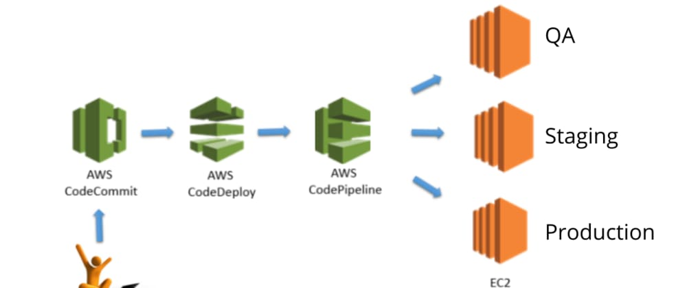
AWS Code Commit, Deploy and Pipeline
AWS Code Commit
AWS Code Commit is a secure, highly scalable, managed source control service that hosts private Git repositories. It makes it easy for teams to securely collaborate on code with contributions encrypted in transit and at rest.
Image Source: https://dev.to/techparida/how-to-build-a-ci-cd-pipeline-in-aws-using-codecommit-codedeploy-codepipeline-hands-on-58cf
Notes:
Left (White Color space):
Title - Parent Topic
Subtitle - Subtopic 1
Body Text - Description in bullets
Right (Grey Color Space):
Body Text - Relevant image (with source)/code snippet
AWS CodeCommit is a secure, highly scalable, managed source control service that hosts private git repositories. CodeCommit eliminates the need for you to operate your own source control system and there is no hardware to provision and scale or software to install, configure, and operate.
Benefits
Fully managed
AWS CodeCommit eliminates the need to host, maintain, back up, and scale your own source control servers. The service automatically scales to meet the growing needs of your project.
Secure
AWS CodeCommit automatically encrypts your files in transit and at rest. CodeCommit is integrated with AWS Identity and Access Management (IAM) allowing you to customize user-specific access to your repositories.
High availability
AWS CodeCommit has a highly scalable, redundant, and durable architecture. The service is designed to keep your repositories highly available and accessible.
Collaborate on code
AWS CodeCommit helps you collaborate on code with teammates via pull requests, branching, and merging. You can implement workflows that include code reviews and feedback by default, and control who can make changes to specific branches.
Faster development lifecycle
AWS CodeCommit keeps your repositories close to your build, staging, and production environments in the AWS cloud. You can transfer incremental changes instead of the entire application. This allows you to increase the speed and frequency of your development lifecycle.
Use your existing tools
AWS CodeCommit supports all Git commands and works with your existing Git tools. You can keep using your preferred development environment plugins, continuous integration/continuous delivery systems, and graphical clients with CodeCommit.
Reference:
https://dev.to/techparida/how-to-build-a-ci-cd-pipeline-in-aws-using-codecommit-codedeploy-codepipeline-hands-on-58cf

Slide 18
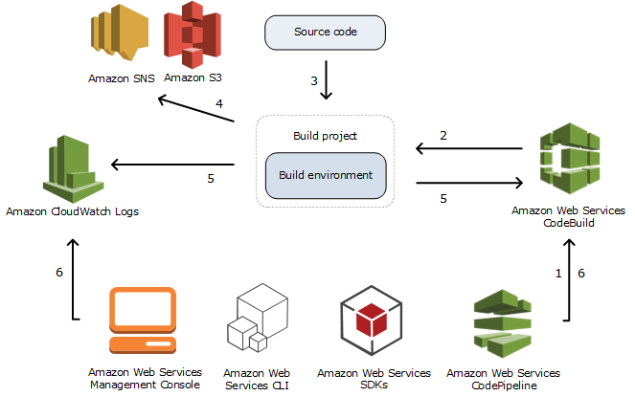
AWS Code Commit, Deploy and Pipeline
AWS Code Build
AWS CodeBuild is a fully managed continuous integration service that compiles source code, runs tests, and produces software packages that are ready to deploy. With CodeBuild, you don't need to provision, manage, and scale your own build servers.
Image Source: https://docs.aws.amazon.com/codebuild/latest/userguide/concepts.html
Notes:
Left (White Color space):
Title - Parent Topic
Subtitle - Subtopic 2
Body Text - Description in bullets
Right (Grey Color Space):
Body Text - Relevant image (with source)/code snippet
AWS CodeBuild is a fully managed continuous integration service that compiles source code, runs tests, and produces software packages that are ready to deploy. The developer would need to provision, manage, and scale your own build servers. CodeBuild scales continuously and can process multiple builds concurrently. CodeBuild offers various pre-configured environments for various versions of Microsoft Windows and Linux. Customers can also bring their customized build environments as Docker containers.
Benefits
Fully managed build service
AWS CodeBuild eliminates the need to set up, patch, update, and manage your own build servers and software. There is no software to install or manage.
Continuous scaling
AWS CodeBuild scales up and down automatically to meet your build volume. It immediately processes each build you submit and can run separate builds concurrently, which means your builds are not left waiting in a queue.
Pay as you go
With AWS CodeBuild, you are charged based on the number of minutes it takes to complete your build. This means you no longer have to worry about paying for idle build server capacity.
Extensible
You can bring your own build tools and programming runtimes to use with AWS CodeBuild by creating customized build environments in addition to the prepackaged build tools and runtimes supported by CodeBuild.
Enables continuous integration and delivery
a family of AWS Code Services, which you can use to create complete, automated software release workflows for continuous integration and AWS CodeBuild belongs to delivery (CI/CD). You can also integrate CodeBuild into your existing CI/CD workflow. For example, you can use CodeBuild as a worker node for your existing Jenkins server setup for distributed builds.
Secure
With AWS CodeBuild, your build artifacts are encrypted with customer-specific keys that are managed by the AWS Key Management Service (KMS). CodeBuild is integrated with AWS Identity and Access Management (IAM), so you can assign user-specific permissions to your build projects
Reference:
https://docs.aws.amazon.com/codebuild/latest/userguide/concepts.html

Slide 19
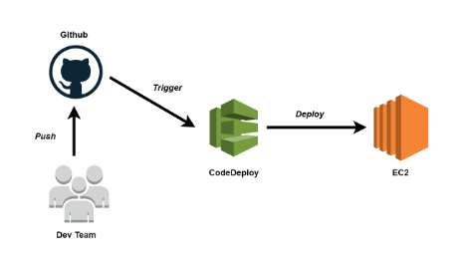
AWS Code Commit, Deploy and Pipeline
AWS Code Deploy
AWS CodeDeploy is a service that automates code deployments to any instance, including Amazon EC2 instances and instances running on-premises
Image Source: https://medium.com/hackernoon/continuous-deployment-with-aws-codedeploy-github-d1eb97550b82
Notes:
Left (White Color space):
Title - Parent Topic
Subtitle - Subtopic 3
Body Text - Description in bullets
Right (Grey Color Space):
Body Text - Relevant image (with source)/code snippet
AWS CodeDeploy is a fully managed deployment service that automates software deployments to a variety of computing services such as Amazon Elastic Compute Cloud (Amazon EC2), AWS Fargate, AWS Lambda, and your on-premises servers. AWS CodeDeploy makes it easier for you to rapidly release new features, helps you avoid downtime during application deployment, and handles the complexity of updating your applications.
Benefits
Automated deployments
AWS CodeDeploy fully automates your software deployments, allowing you to deploy reliably and rapidly. You can consistently deploy your application across your development, test, and production environments whether deploying to Amazon EC2, AWS Fargate, AWS Lambda, or your on-premises servers. The service scales with your infrastructure.
Minimize downtime
AWS CodeDeploy helps maximize your application availability during the software deployment process. It introduces changes incrementally and tracks application health according to configurable rules. Software deployments can easily be stopped and rolled back if there are errors.
Centralized control
AWS CodeDeploy allows you to easily launch and track the status of your application deployments through the AWS Management Console or the AWS CLI. CodeDeploy gives you a detailed report allowing you to view when and to where each application revision was deployed. You can also create push notifications to receive live updates about your deployments.
Easy to adopt
AWS CodeDeploy is platform and language agnostic, works with any application, and provides the same experience whether you’re deploying to Amazon EC2, AWS Fargate, or AWS Lambda. You can easily reuse your existing setup code. CodeDeploy can also integrate with your existing software release process or continuous delivery toolchain (e.g., AWS CodePipeline, GitHub, Jenkins).
Reference:
https://medium.com/hackernoon/continuous-deployment-with-aws-codedeploy-github-d1eb97550b82

Slide 20
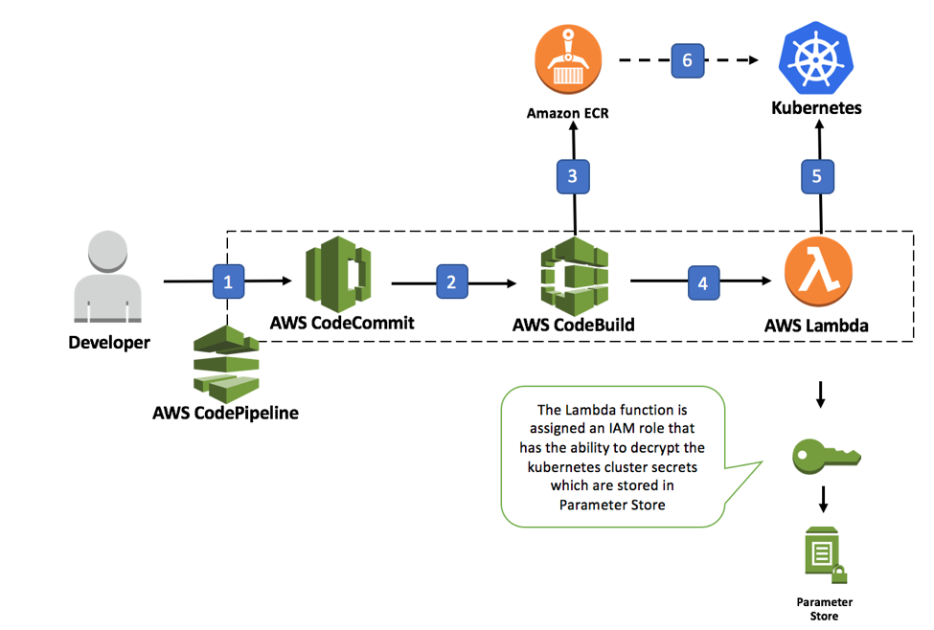
AWS Code Commit, Deploy and Pipeline
AWS Code Pipeline
AWS Code Pipeline is a continuous delivery service you can use to model, visualize, and automate the steps required to release your software.
Image Source: https://d2908q01vomqb2.cloudfront.net/7719a1c782a1ba91c031a682a0a2f8658209adbf/2018/01/11/k8s-code.png
Notes:
Left (White Color space):
Title - Parent Topic
Subtitle - Subtopic 4
Body Text - Description in bullets
Right (Grey Color Space):
Body Text - Relevant image (with source)/code snippet
AWS CodePipeline is a continuous delivery service you can use to model, visualize, and automate the steps required to release your software. You can quickly model and configure the different stages of a software release process. CodePipeline automates the steps required to release your software changes continuously.
Benefits
Rapid delivery
AWS CodePipeline automates your software release process, allowing you to rapidly release new features to your users. With CodePipeline, you can quickly iterate on feedback and get new features to your users faster.
Automating your build, test, and release process allows you to quickly and easily test each code change and catch bugs while they are small and simple to fix. You can ensure the quality of your application or infrastructure code by running each change through your staging and release process.
Configurable workflow
AWS CodePipeline allows you to model the different stages of your software release process using the console interface, the AWS CLI, AWS CloudFormation, or the AWS SDKs. You can easily specify the tests to run and customize the steps to deploy your application and its dependencies.
Get started fast
With AWS CodePipeline, you can immediately begin to model your software release process. There are no servers to provision or set up. CodePipeline is a fully managed continuous delivery service that connects to your existing tools and systems.
Easy to integrate
AWS CodePipeline can easily be extended to adapt to your specific needs. You can use our pre-built plugins or your own custom plugins in any step of your release process. For example, you can pull your source code from GitHub, use your on-premises Jenkins build server, run load tests using a third-party service, or pass on deployment information to your custom operations dashboard.
Reference:
https://d2908q01vomqb2.cloudfront.net/7719a1c782a1ba91c031a682a0a2f8658209adbf/2018/01/11/k8s-code.png

